Slide 1

Network Forensics: Visualization of Log-Files Using Apache Hadoop into 3d Analysis
By: Osama Akhtar
Dr. Roy George, CIS Dept.
Clark Atlanta University, Summer 2014

Slide 2
Introduction: Why Analyze Log-File Data?
The primary reason is because of security breaches which can cause data that has been affected to be analyzed.
Log-file data analization is used to analyze data 100’s of megabytes to gigabytes long.
The examined data is also used to benchmark how previous software compare to Hadoop.

Slide 3
How Hadoop Log-File Analysis Works
Below is a good explanation of how Hadoop Log-File Analysis works:
https://www.youtube.com/watch?v=BPC_mClNSXk

Slide 4
Research Already Done
Much research has already been conducted in the area of log-file analysis.
These slides focus on the specific research done by outside sources on log-file analysis.
The following slides will describe the amount of research and what kind of research has been conducted on log-file analysis and visualization

Slide 5
Research Already Done
A high-level analysis log-file data project was conducted in a tutorial via Apache Hadoop
Apache Flume collects and analyzes high-volume data by streaming it and then displays it in Apache Pig
Microsoft Excel is used to analyze the resulting graph data

Slide 6
Previous Research Using Benchmarking with MapReduce
The large amount of data (Gigabytes) was stored using x-Mon
The data was aggregated and extracted using MapReduce
The data was then tested using Hadoop Clusters
Finally, the data was compared between Hadoop and MongoDB using MapReduce

Slide 7
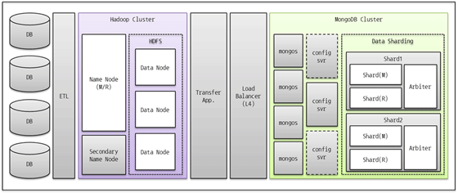
Previous Research Using Benchmarking with MapReduce
Final output internal system configuration diagram:

Slide 8
Previous Research: Using Linux
Get Hadoop running
Interact with the HDFS
Write a simple MapReduce application
Write a simple pig query
Write an aggregate pig query

Slide 9
Using SQL with Log Analytics
Star cluster and load logs
Perform queries using Apache Hive
Manipulate data using SQL

Slide 10
Companies that Use Log-File Analytics
IBM
Dell
AOL
Glassbeam
Retail

Slide 11
Log-Files Visualization and Analysis Goal
The goal of this research will be to extract and download a log-file data 100’s of megabytes long
Analyze it and program it
Then to visualize it using coding with software.

Slide 12
Analysis
First, the Million song dataset and the wikipedia database dataset were downloaded.
Then, transferred to the hadoop folder.
Then, they were programmed in hadoop using Pig.
Then, the CSV data was transferred to a text file.
Finally, the CSv and txt file data was visualised in a 3d software visualization program.

Slide 13
Million Song Dataset
This is a compilation of over 1 million songs totaling over 5gb worth of data.
Foreign and US music is used, particularly larger music files.
This dataset will be used to identify 3d patterns of data

Slide 14
Wikipedia Database Dump
This is a compilation of all of Wikipedia files and entries
This totals 7gb worth of data
This will be used for 3d analysis.

Slide 15
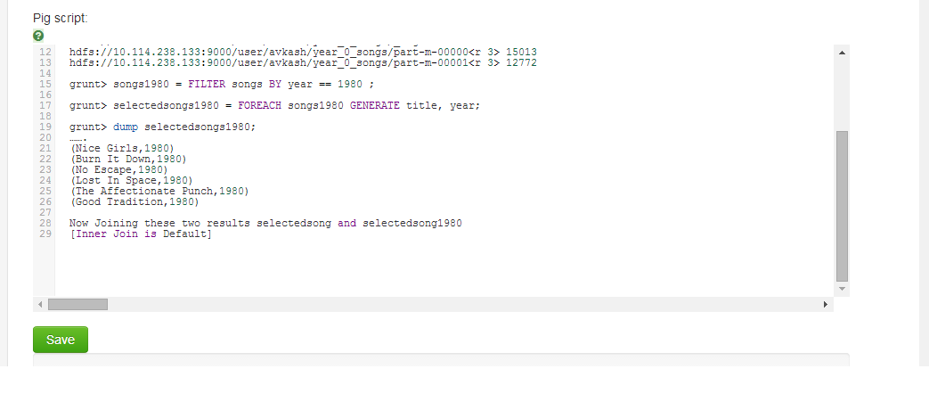
Pig Program: Million Song Dataset
Below is the Pig program that was developed:

Slide 16
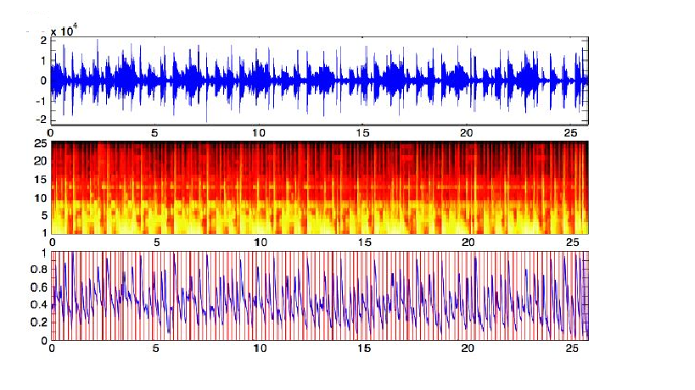
Million Song Dataset 3d Graph 1
The first graph is a graph of 1 million songs:

Slide 17
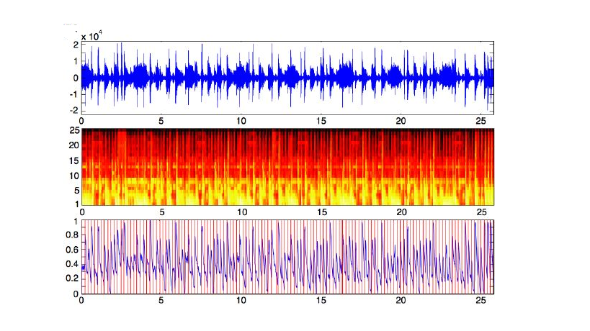
Million Song Dataset: 3d Graph 2
This is a graph depicting a specific song occurrence in the 3d graph:

Slide 18
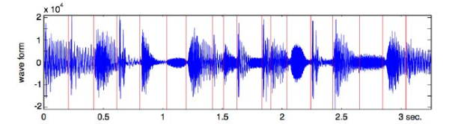
Million Song Dataset 3d Graph 2
This is the close-up of the 3d wave form of the million song dataset. It contains
over 1,000,000 songs and 10,000,000 lines of record:

Slide 19
Results
3d graphs were able to be successfully completed.
The 3d graphs were able to be successfully made in 3d waveforms and 3d bar graphs.
However, using 3d visualization tools are very complex and difficult to learn.

Slide 20
Conclusion
Extremely large files from 1gb to 20gb can crash one’s computer
If successful, 3d graphs will produce a very smooth graph with high rise and inflection point.
3d helps to analyze data better than static form and can be easily read

Slide 21
Future Work
More research into the areas of 3d visualization
Possible combination of 3d visualization and fingerprinting for the thesis.

Slide 22
References
https://www.youtube.com/watch?v=BPC_mClNSXk
http://hortonworks.com/hadoop-tutorial/how-to-refine-and-visualize-server-log-data/
http://www.cubrid.org/blog/dev-platform/log-analysis-system-using-hadoop-and-mongodb/
http://www.ibm.com/developerworks/linux/library/os-log-process-hadoop/index.html?ca=dat
http://help.papertrailapp.com/kb/analytics/log-analytics-with-hadoop-and-hive
http://www.simonbuckle.com/2011/09/01/using-hadoop-to-analyze-apache-log-files/

Slide 23
References (continued)
7. http://www.techradar.com/us/news/world-of-tech/roundup/software/applications/using-hadoop-in-big-data-analysis-1126743
8. http://www.ymc.ch/en/case-study-retail-wifi-log-file-analysis-with-hadoop-and-impala-part-1
9. www.avs.com
10. http://dumps.wikimedia.org/archive/enwiki/20060816/
11. www.d3-js.org
12. www.de-generator.com
13. http://www.upriss.org.uk/fca/cstiw11wiki.html

